Slide 1

Progress Update
Fenn Leppard - Group Meeting – 17/04/24

Slide 2
Summary
Working on fixing Juno MAG code:
  I have a working test code, need to generalise and introduce B_{Parallel}.
  Once working I will reproduce my MAG plots.
Low Resolution Electron JEDI code still broken
Expanded, re-binned and shifted XMM data to account for light travel time.

Slide 3
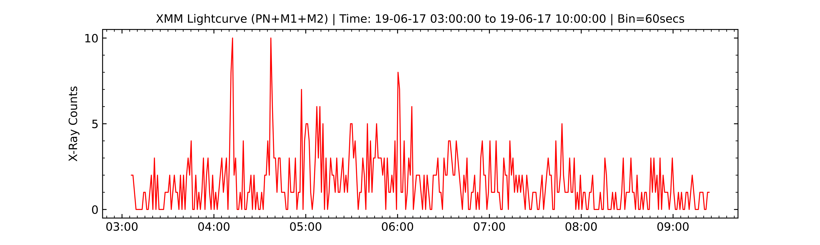
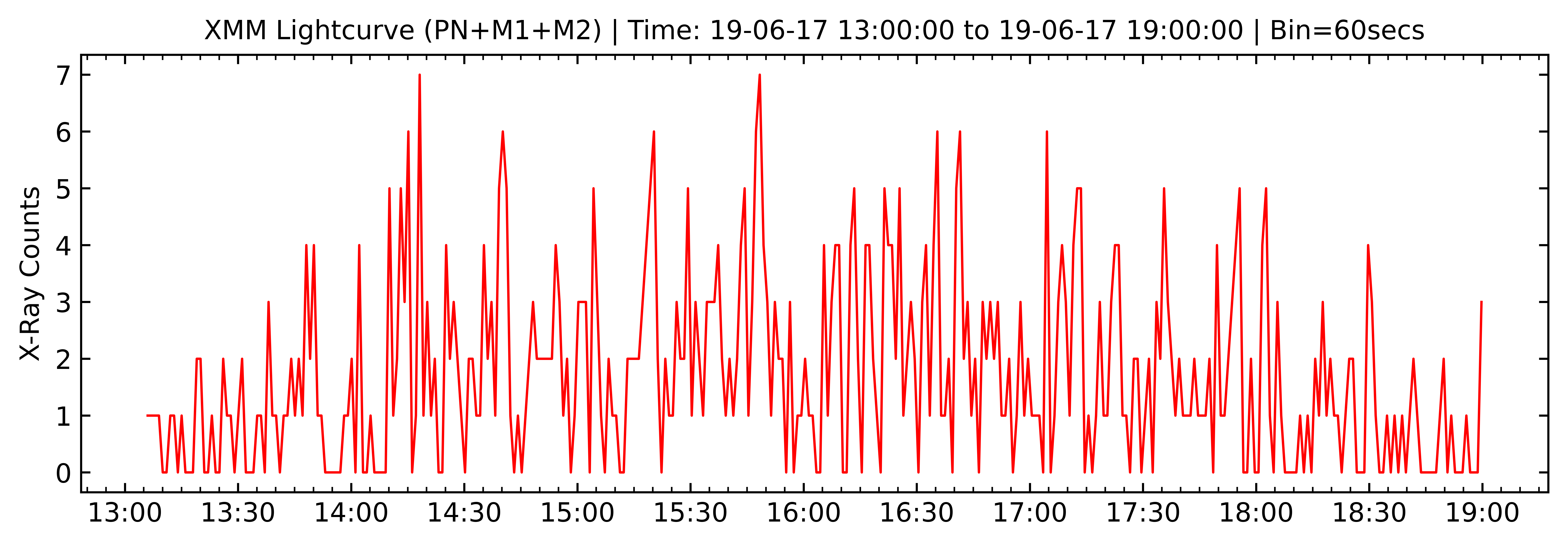
2017 – 06 – 19
Juno at ~110 RJ during this time – Very outer edge of magnetosphere.
Some large peaks along with very rapid pulsations (~2 mins)
Large Peaks
Rapid Pulsations ~ 2 Mins

Slide 6
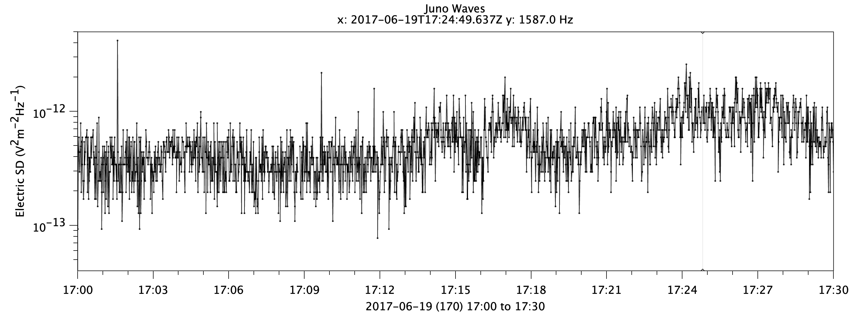
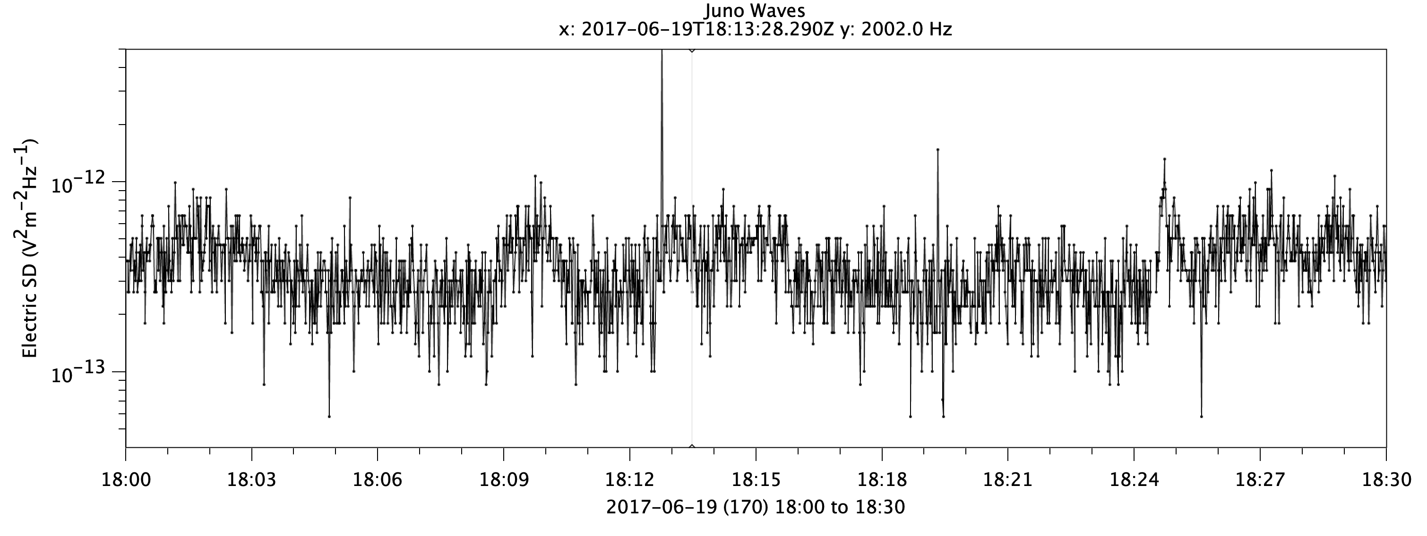
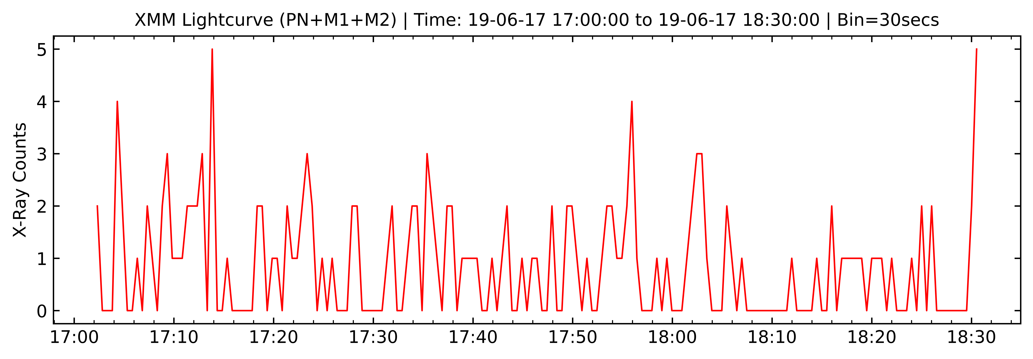

Slide 7
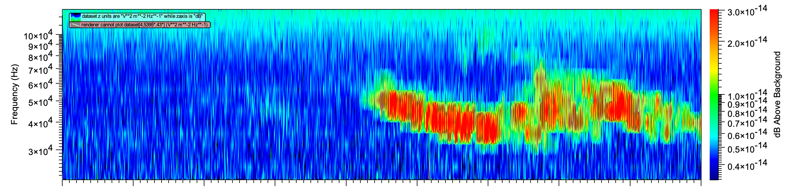
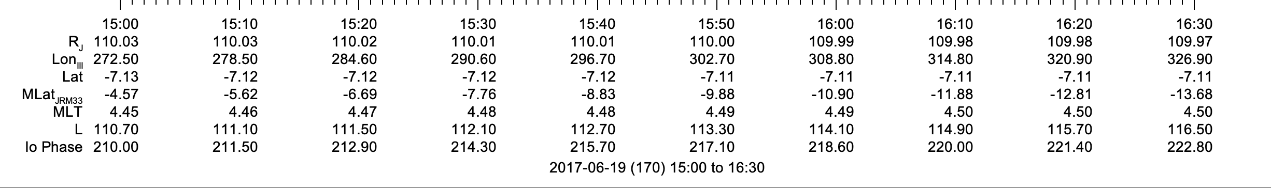
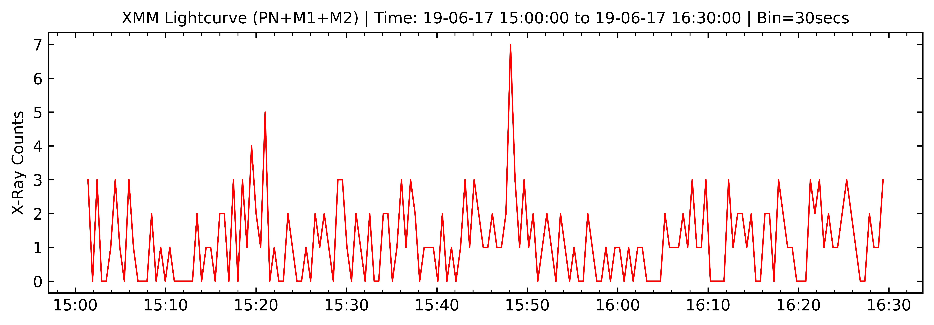

Slide 8
